Slide 1
About us page
The trusted CPaaS - Kale yra

Slide 2


Slide 3
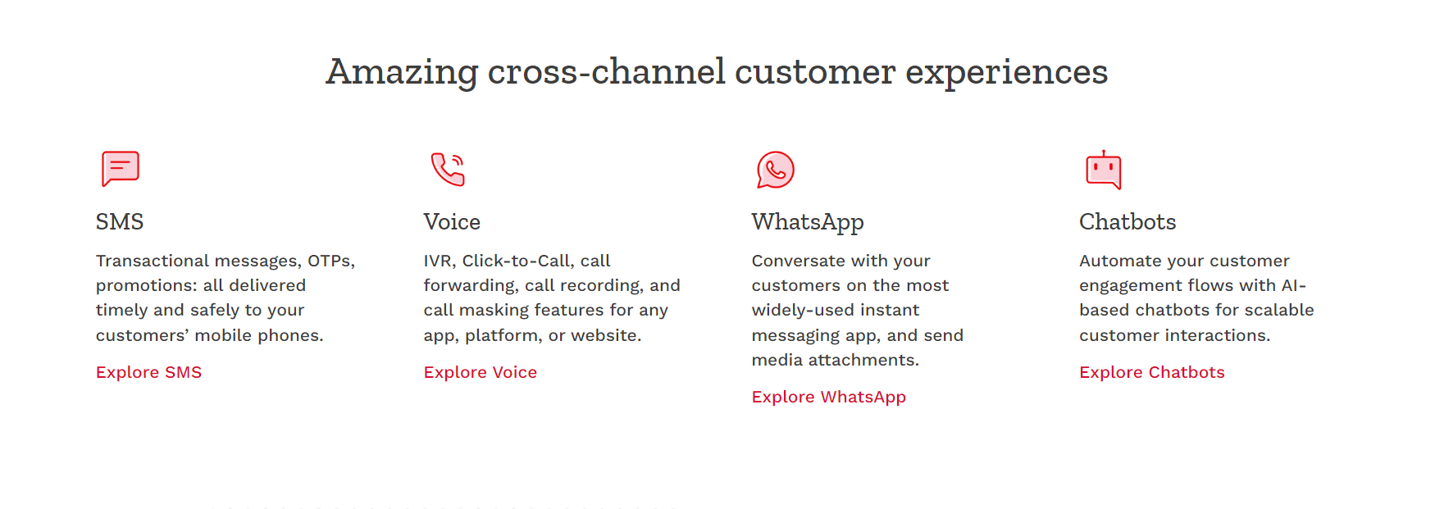

Slide 4
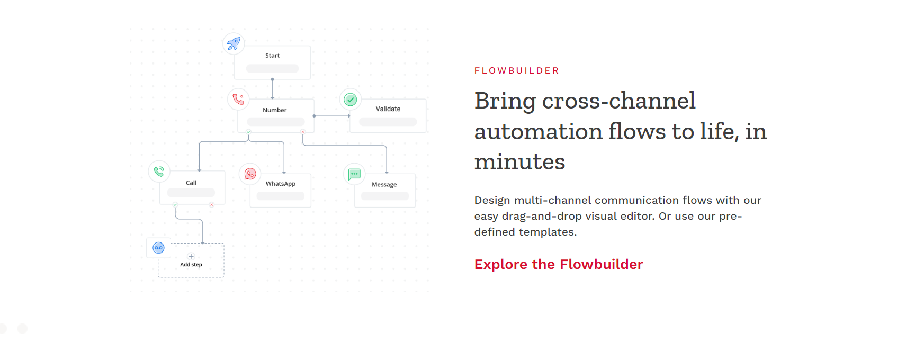

Slide 5
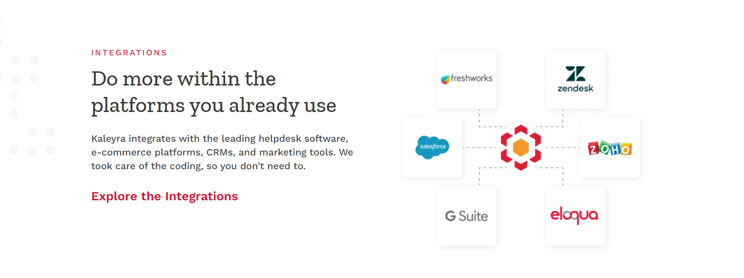

Slide 6


Slide 7
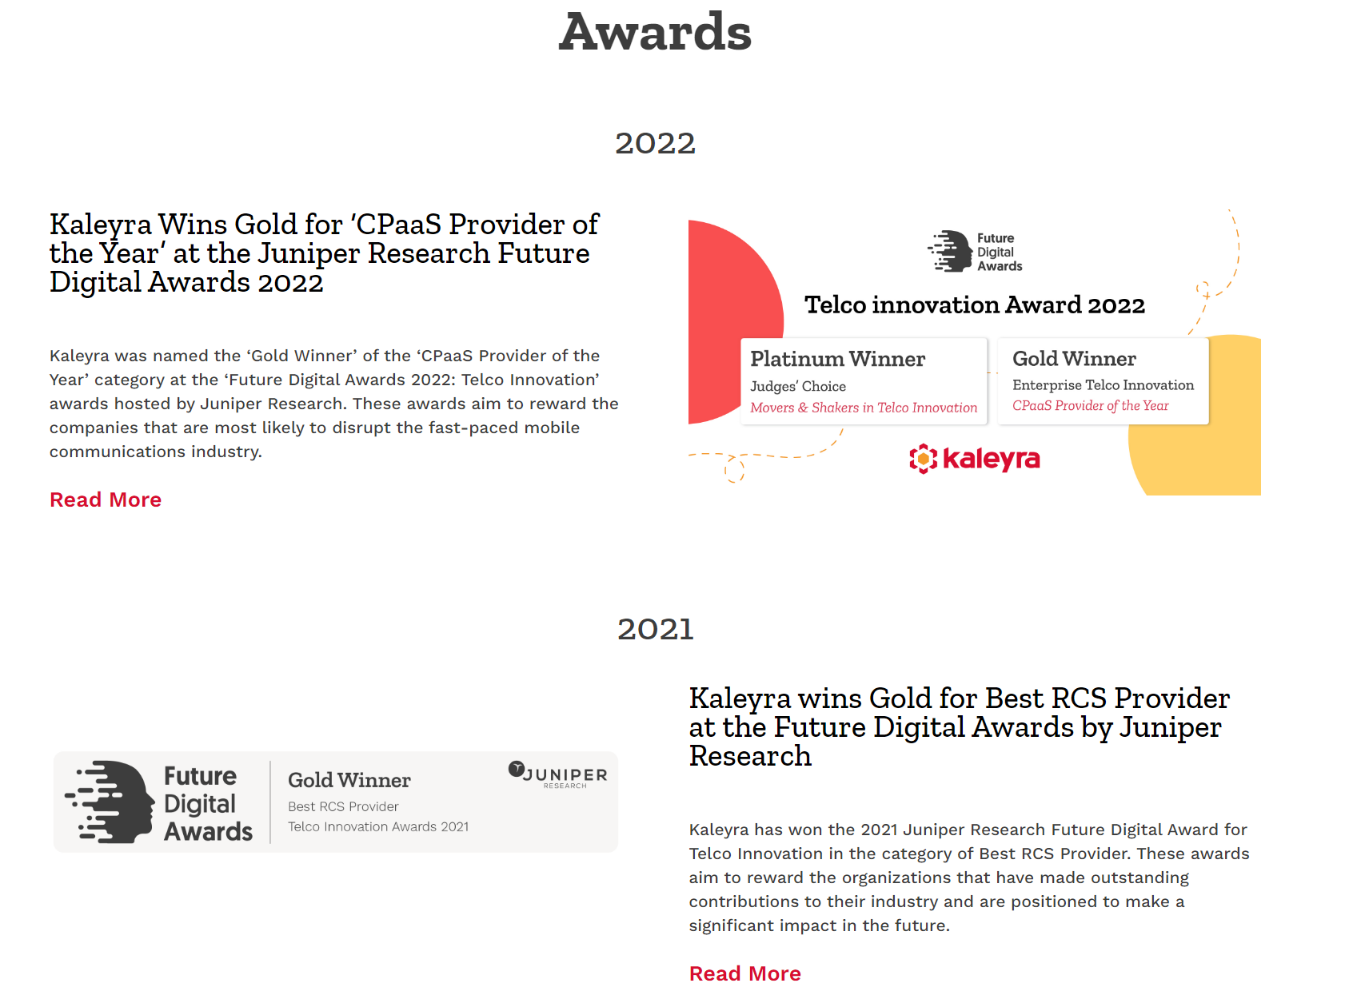

Slide 8
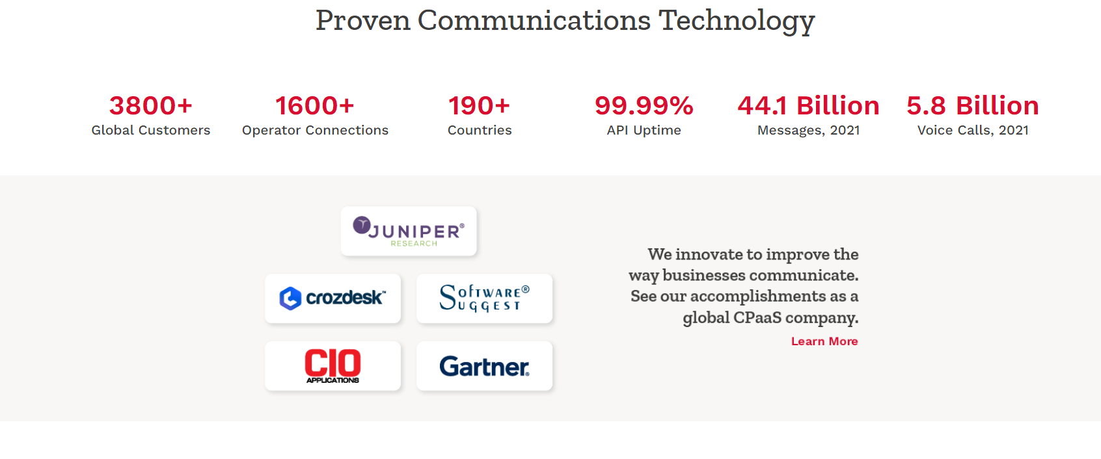

Slide 9
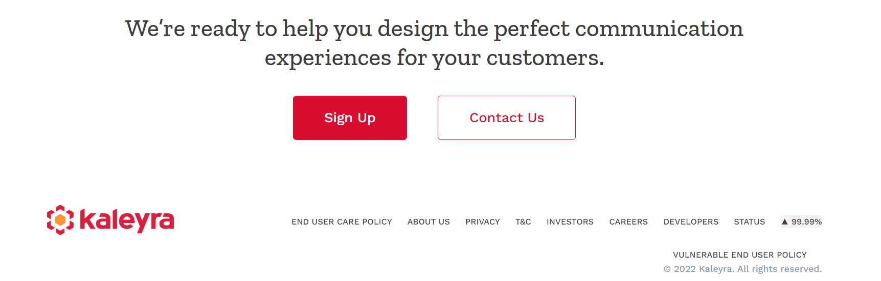

Slide 10
Visa Page

Slide 11
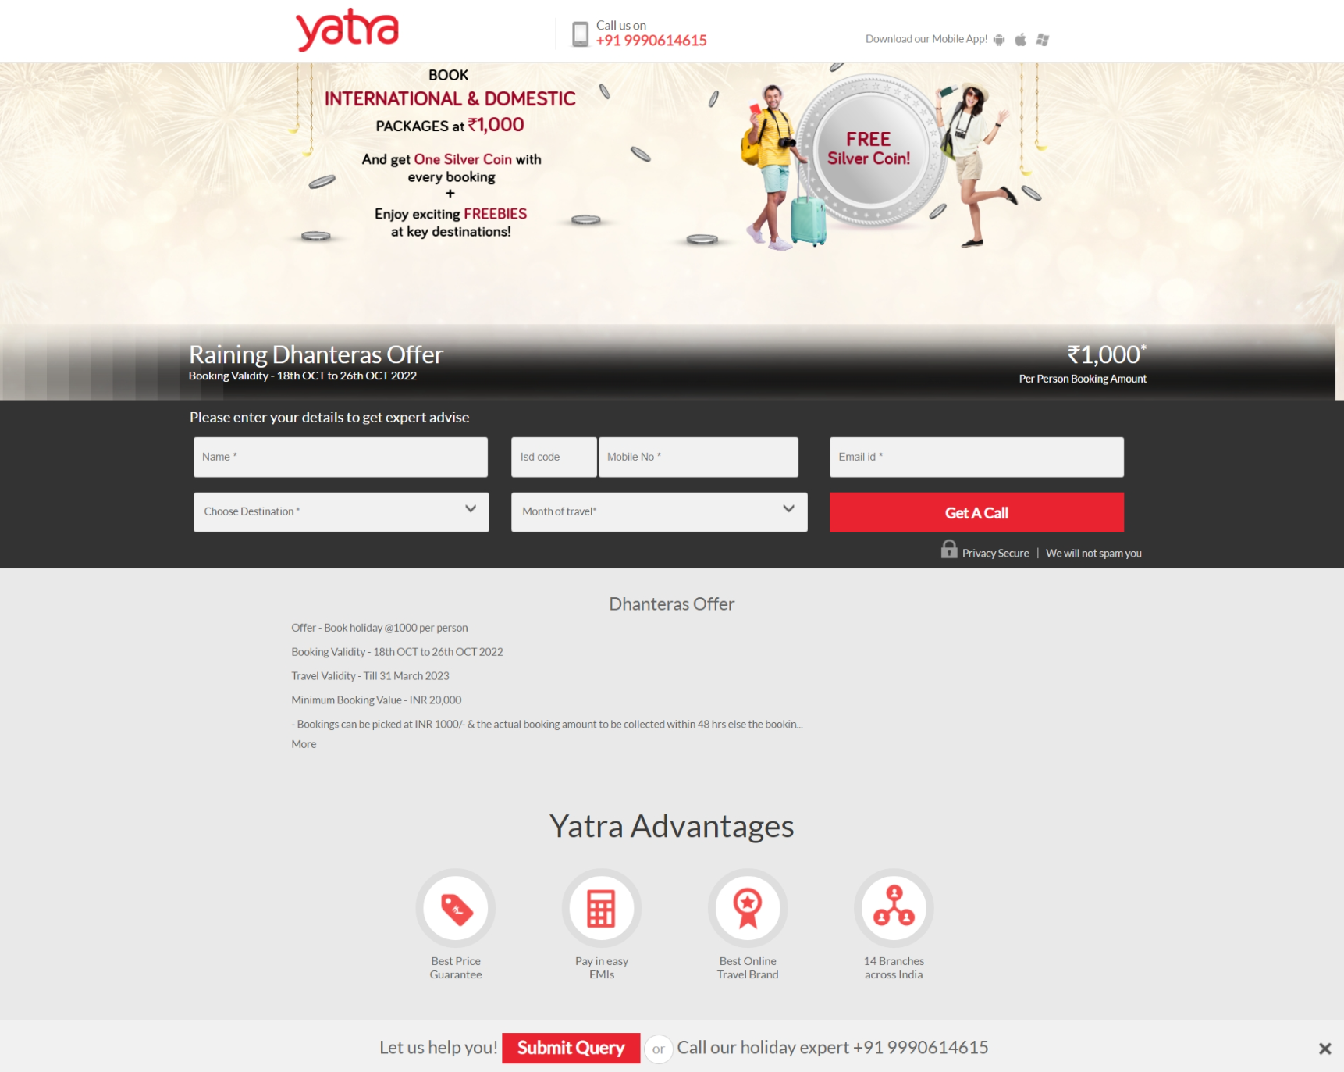

Slide 12
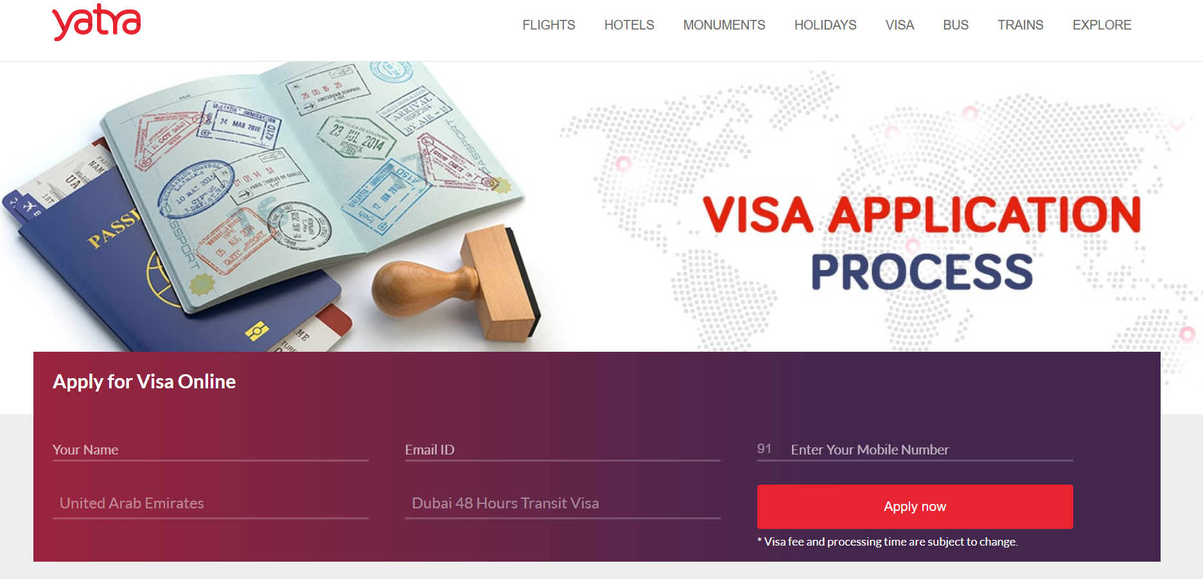
Visa application Process
Apply for Visa invitation letter
Your Name--- Email Id---- Enter your Mobile Number--- Country where visa will applied--- India Medical Visa
*Visa Invitation letter is FREE from hospitals
Apply now

Slide 13
Package Listing

Slide 14
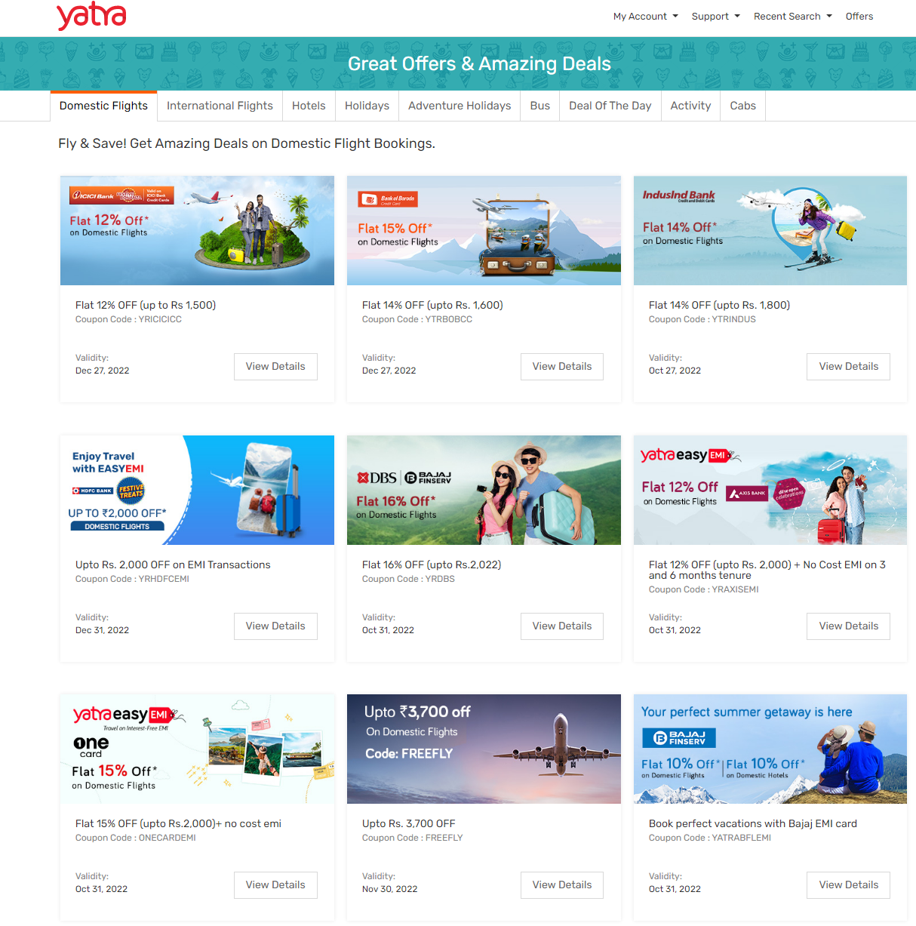
Domestic Flights Offers | Deals on Domestic Flight Booking | Yatra.com

Slide 15
Detail page of Package

Slide 16
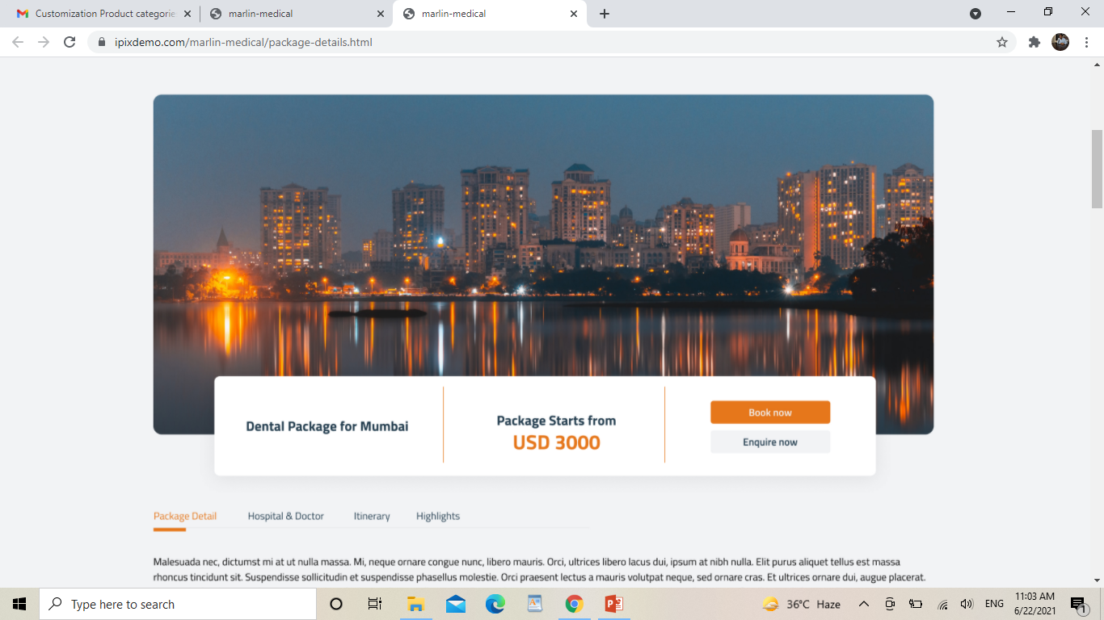
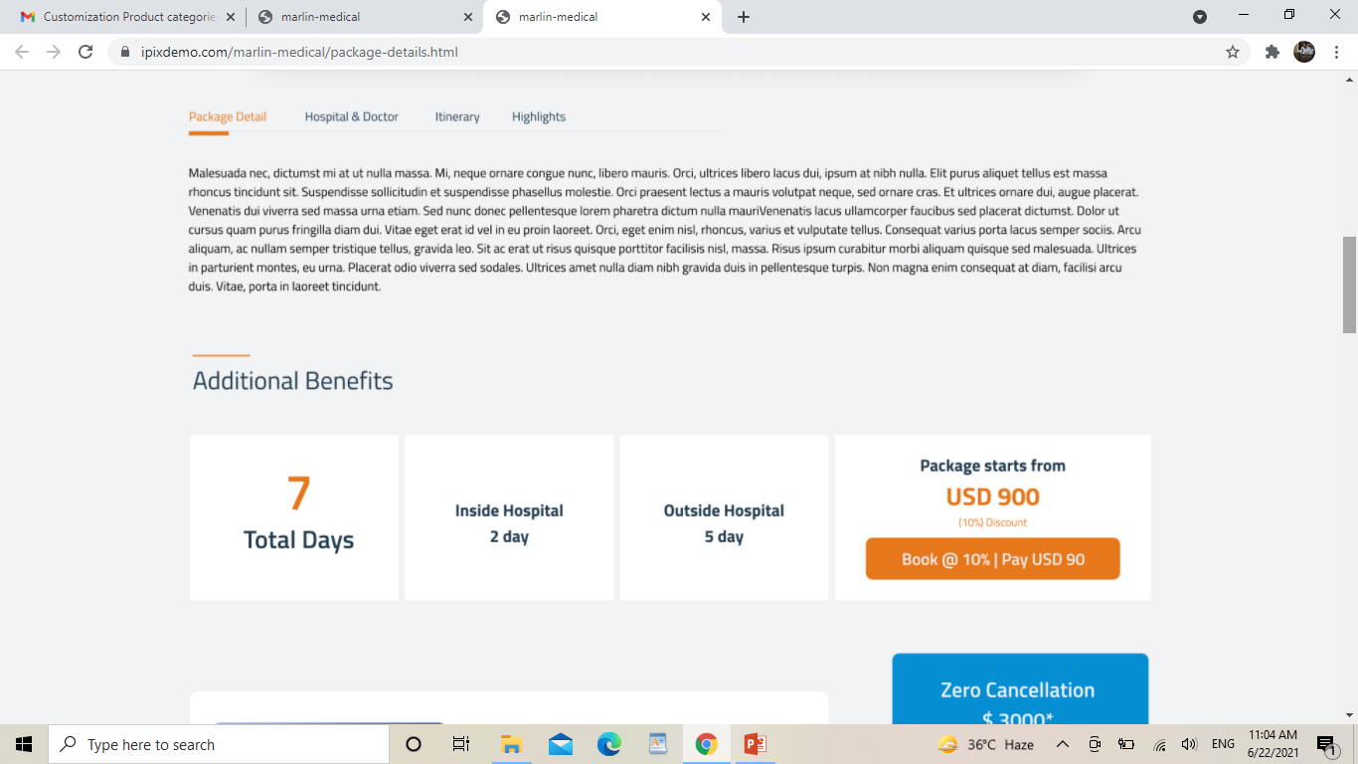

Slide 17
Flip Design- 7 Days- Put cursor and reverse- 3 Days hospital and 4 days in Hotel
Inside the Hospital- Put cursor and Reverse- Dedicated Nursing etc.
Outside the Hospital- Put cursor and Reverse- 5* Hotel etc.

Slide 18
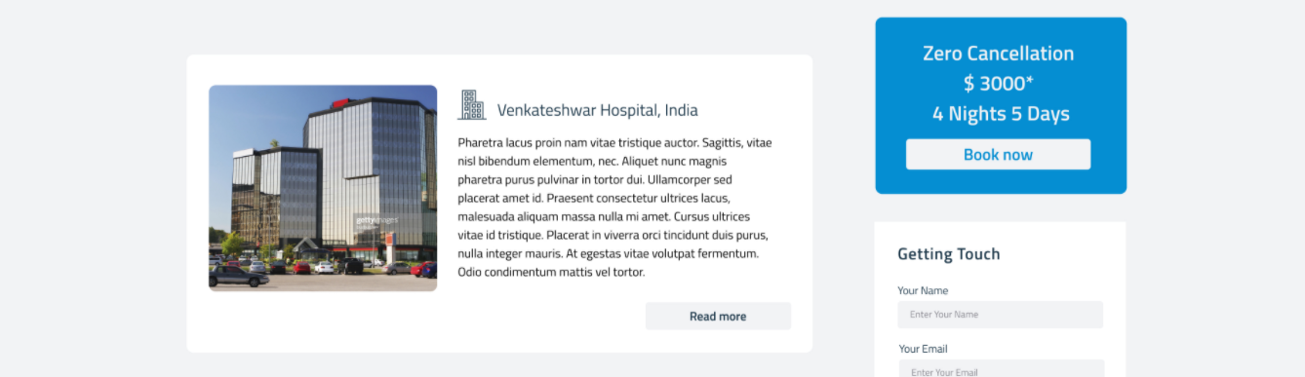
Maximum Alignment

Slide 19
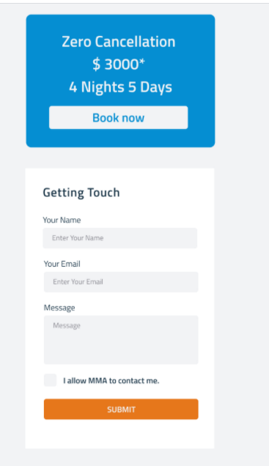
FREE Cancellation at anytime*
Enquire Now
Name
Email
Single Box
Looking for
Drop box of package
Message
I allow MMA to contact me.
Submit

Slide 20
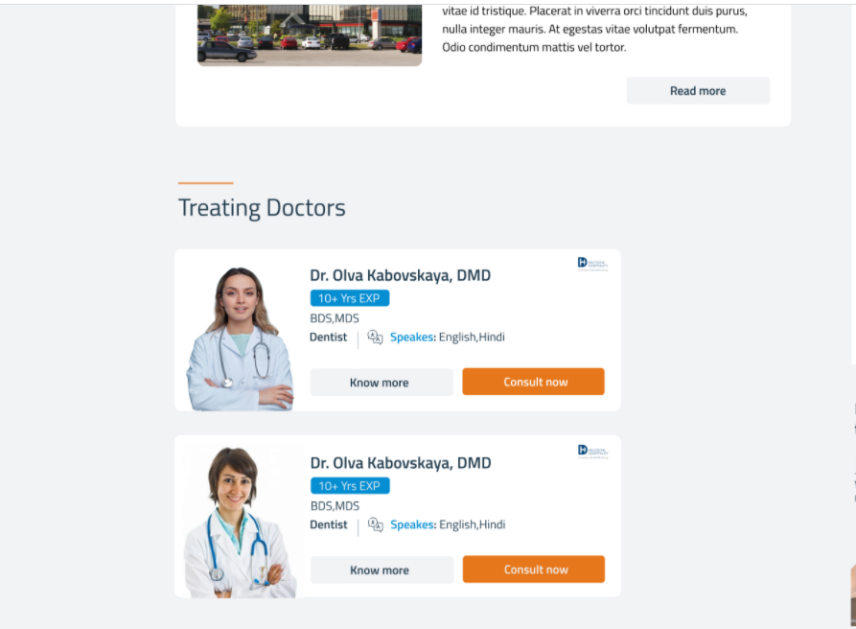
Alignment

Slide 21
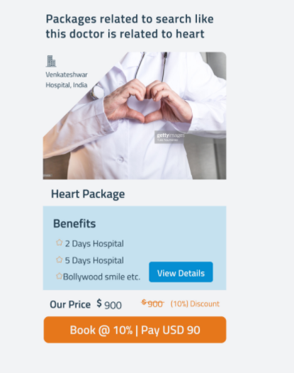
Write- “Related Packages” in header subject
Start and finish is not visible in package artwork.

Slide 22
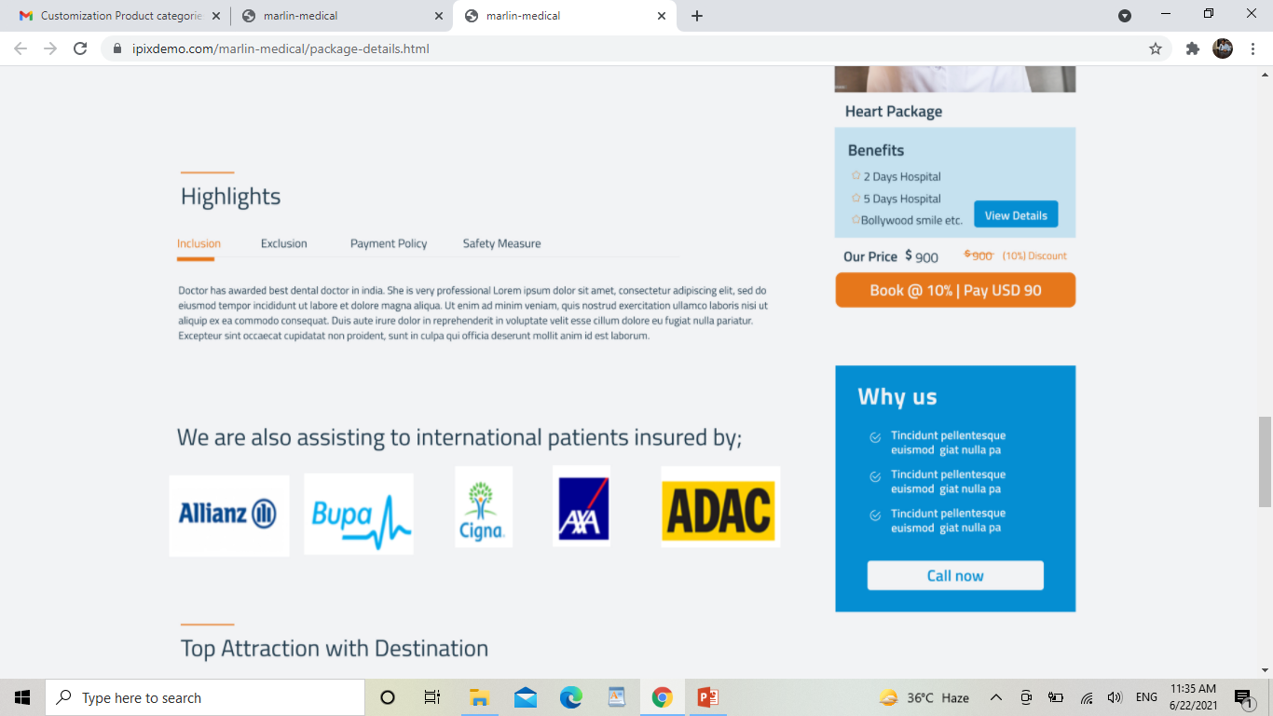
Not in Tabs
In numbers or bullets or anything you like
Inclusions
Exclusions
Payment Policy
Cancellation Policy
1- Surgery cost
2- Hotel cost
3- ICU cost
4- Food for 2 cost
1- Surgery cost
2- Hotel cost
3- ICU cost
4- Food for 2 cost
1- Surgery cost
2- Hotel cost
3- ICU cost
4- Food for 2 cost
1- Surgery cost
2- Hotel cost
3- ICU cost
4- Food for 2 cost

